Slide 1
RIDDLES

Slide 2
RIDDLE:
Two fathers and two sons are in a car, yet there are only three people in the car. How?

Slide 3
SOLUTION:
They are a grandfather, father and son.

Slide 4
RIDDLE :
I’m tall when I’m young, and I’m short when I’m old. What am I?

Slide 5
SOLUTION:
A Candle

Slide 6
RIDDLE :
Which liquid turns into solid when heating?

Slide 7
SOLUTION:
Idly

Slide 8
RIDDLE :
(POV: Science group students) Students of arts group keep on fighting with their teachers. Why?

Slide 9
SOLUTION:
They don't have chemistry.

Slide 10
RIDDLE :
RIDDLE :
What word in the English language does the following: the first two letters signify a male, the first three letters signify a female, the first four letters signify a great, while the entire world signifies a great woman. What is the word?

Slide 11
SOLUTION:
Heroine

Slide 12
RIDDLE :
What comes once in a minute, twice in a moment, but never in a thousand years?

Slide 13
SOLUTION:
The letter “M”

Slide 14
RIDDLE :
Which will burn longer: the candles on the birthday cake of a boy or the candles on the birthday cake of a girl?

Slide 15
SOLUTION:
No candles burn longer–they all burn shorter.

Slide 16
RIDDLE :
What five-letter word stays the same when you take away the first, third, and last letter?

Slide 17
SOLUTION:
Empty.

Slide 18
RIDDLE :
You go at red and stop at green. What am I?

Slide 19
SOLUTION:
A watermelon

Slide 20
RIDDLE :
A man calls his dog from the opposite side of the river. The dog crosses the river without getting wet, and without using a bridge or boat. How?

Slide 21
SOLUTION:
The river was frozen

Slide 22
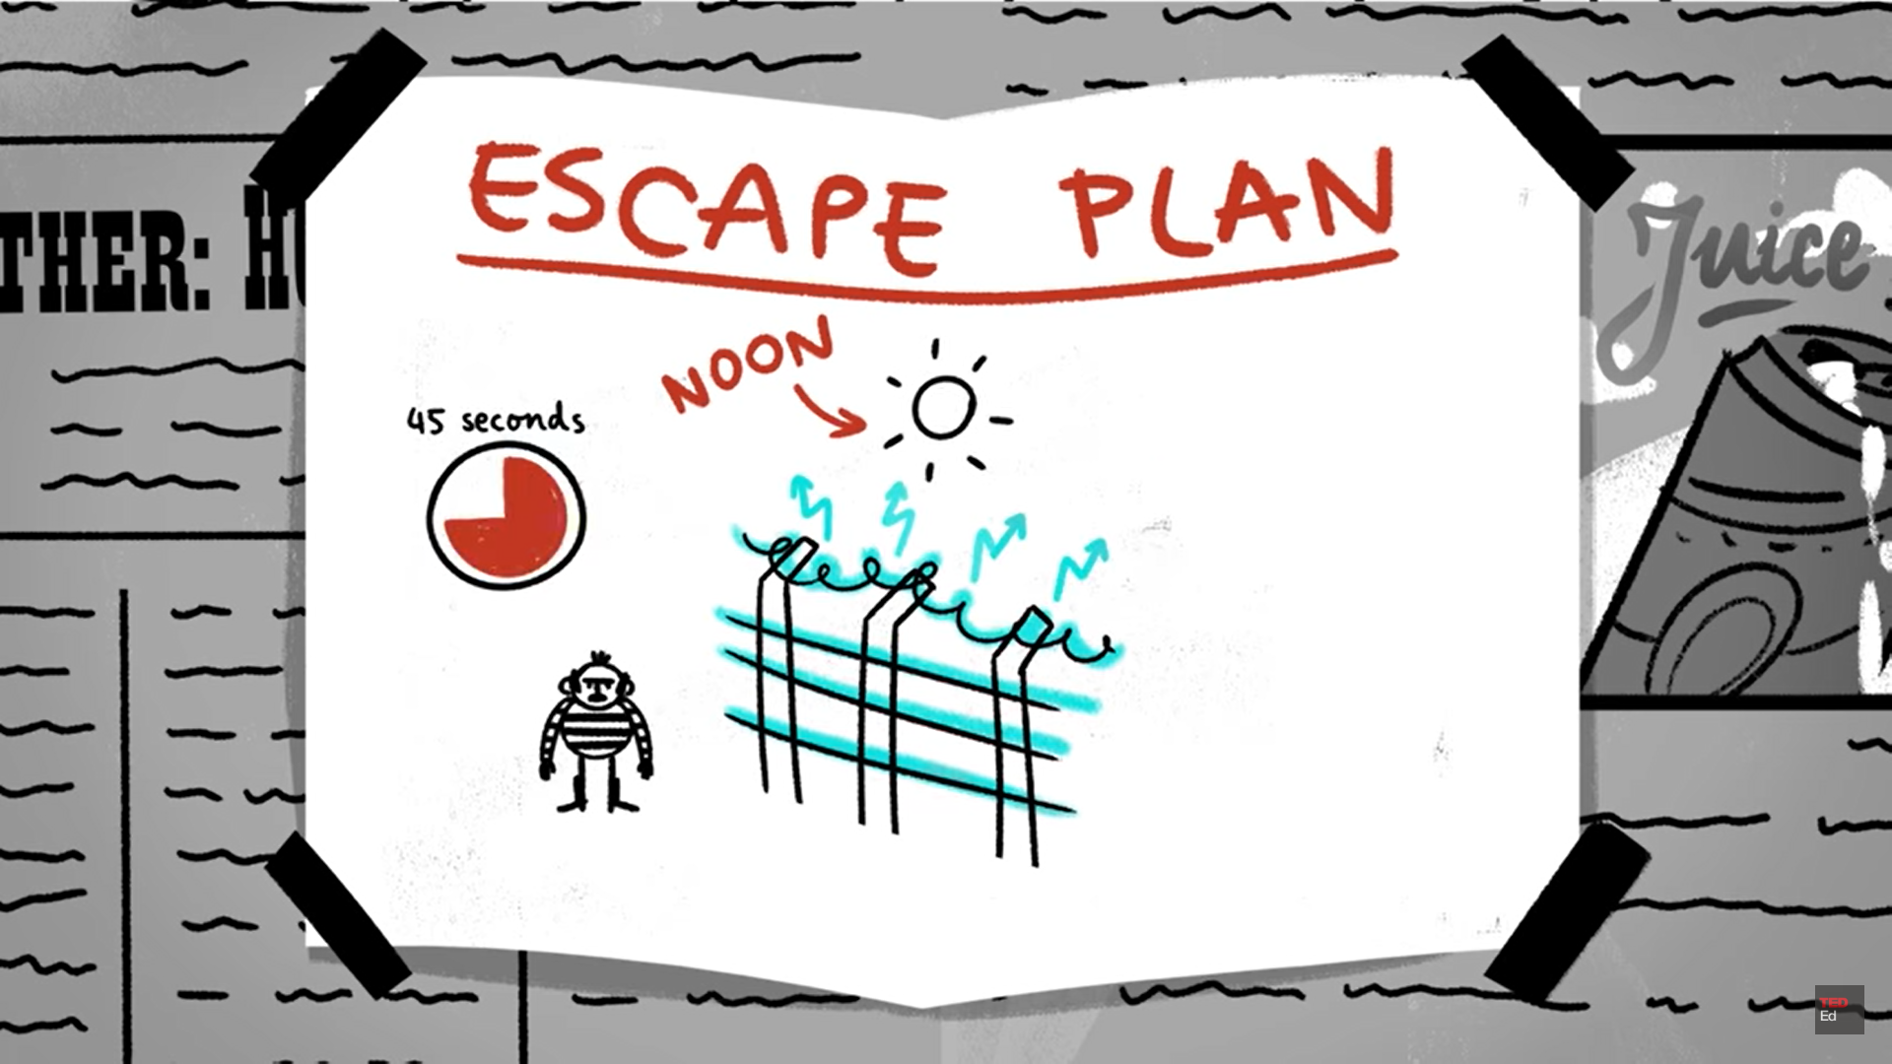

Slide 23
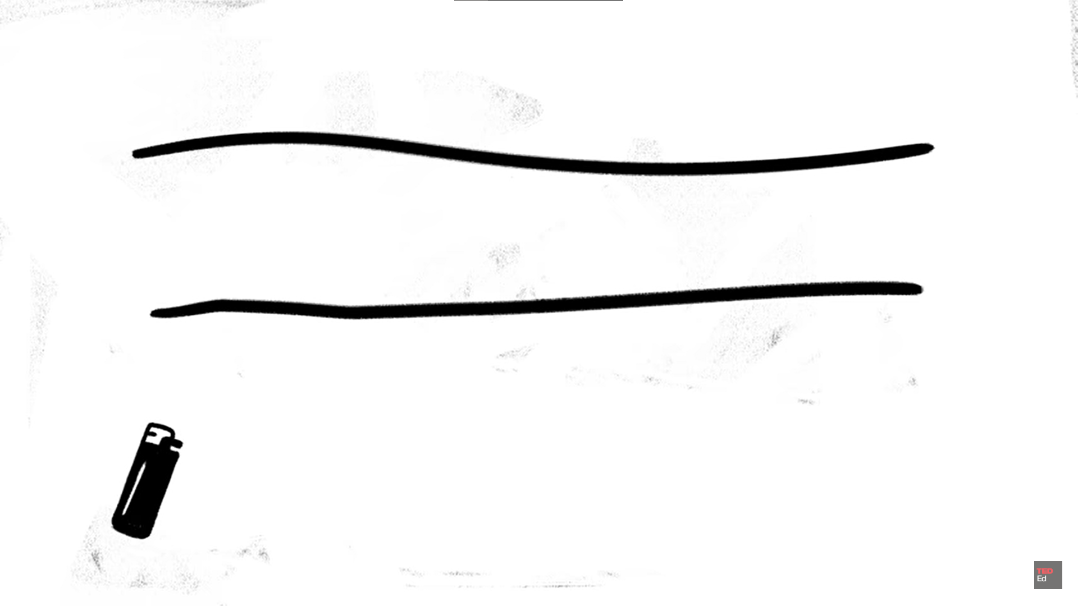

Slide 24
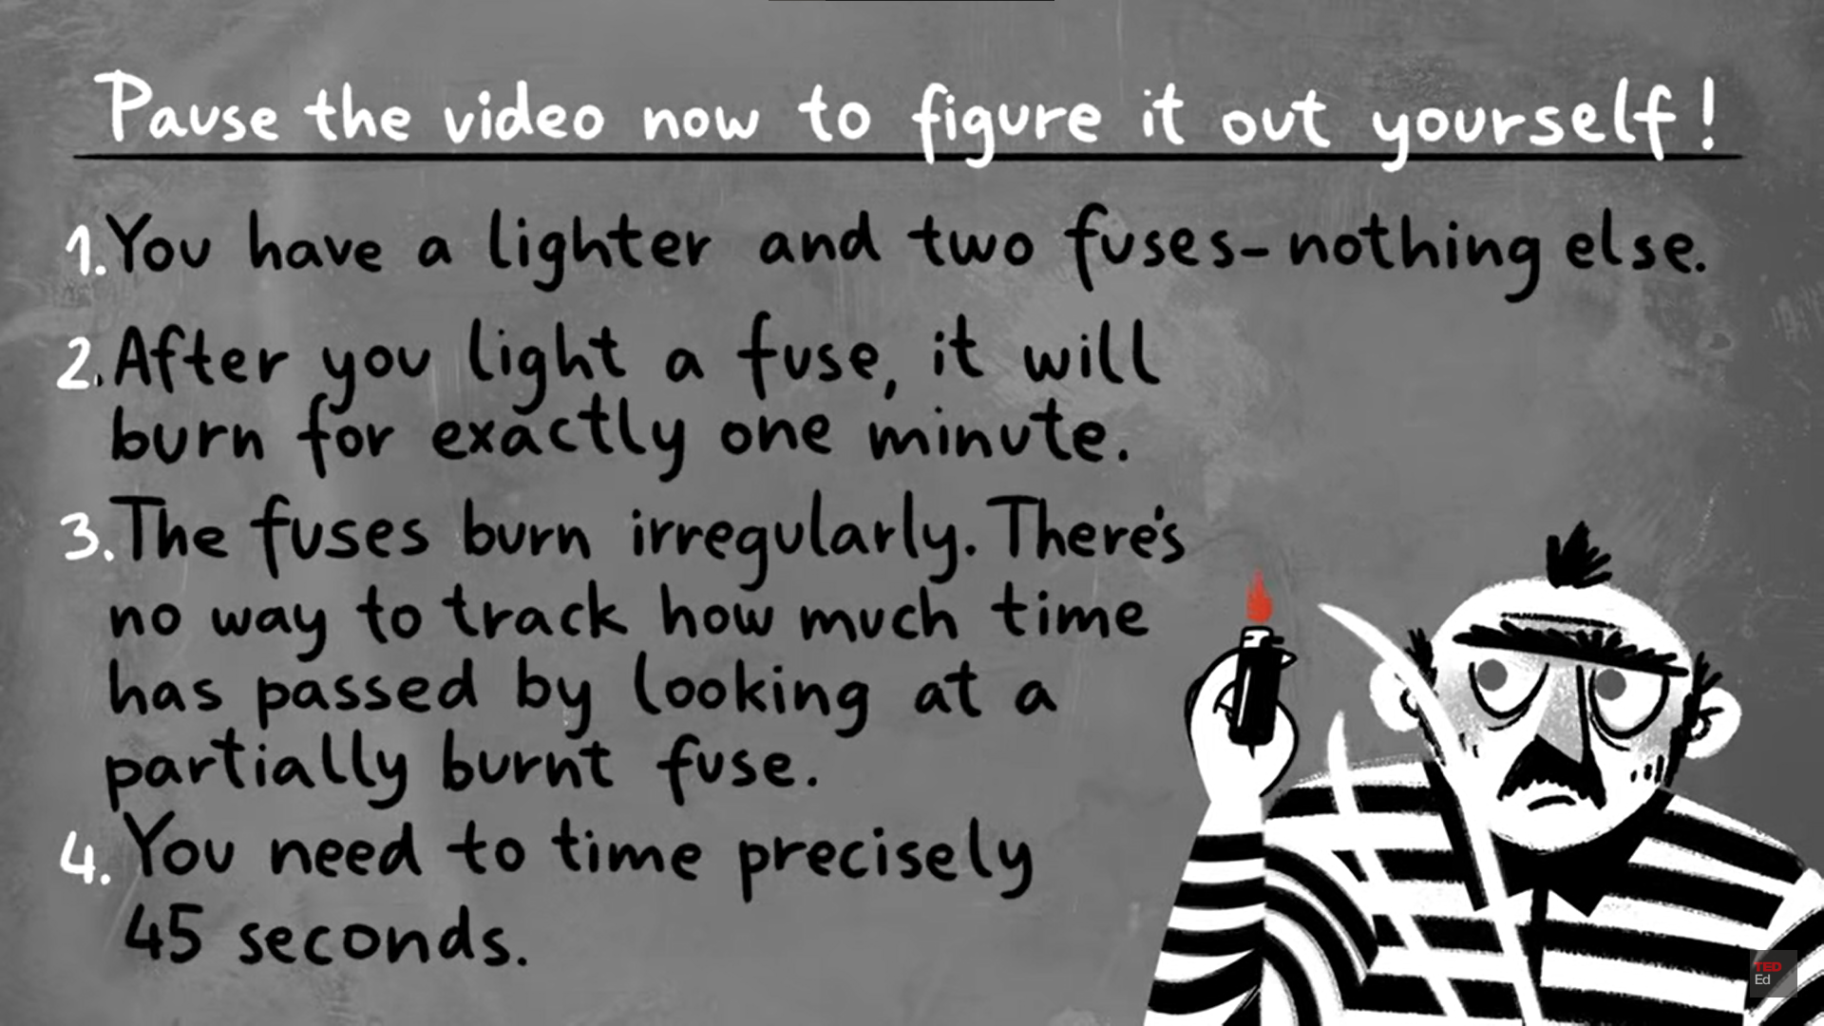

Slide 25
SOLUTION:
Burn both ends of one wire and one end of one wire
When the first wire burn down completely there will be 30 seconds over
Lit the second end of second wire. It’ll burn for 15 seconds.
When it completes burning 45 seconds will be over

Slide 26
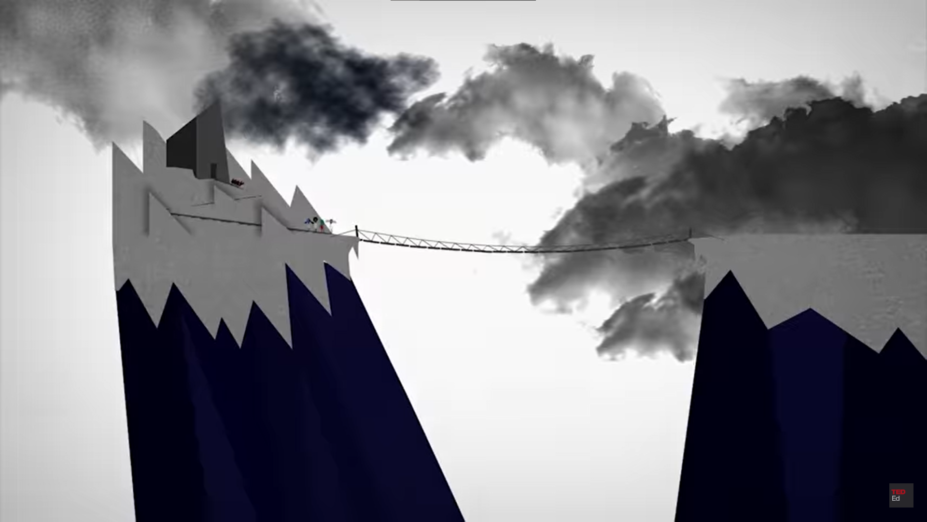


Zombies
Your Gang

Slide 27
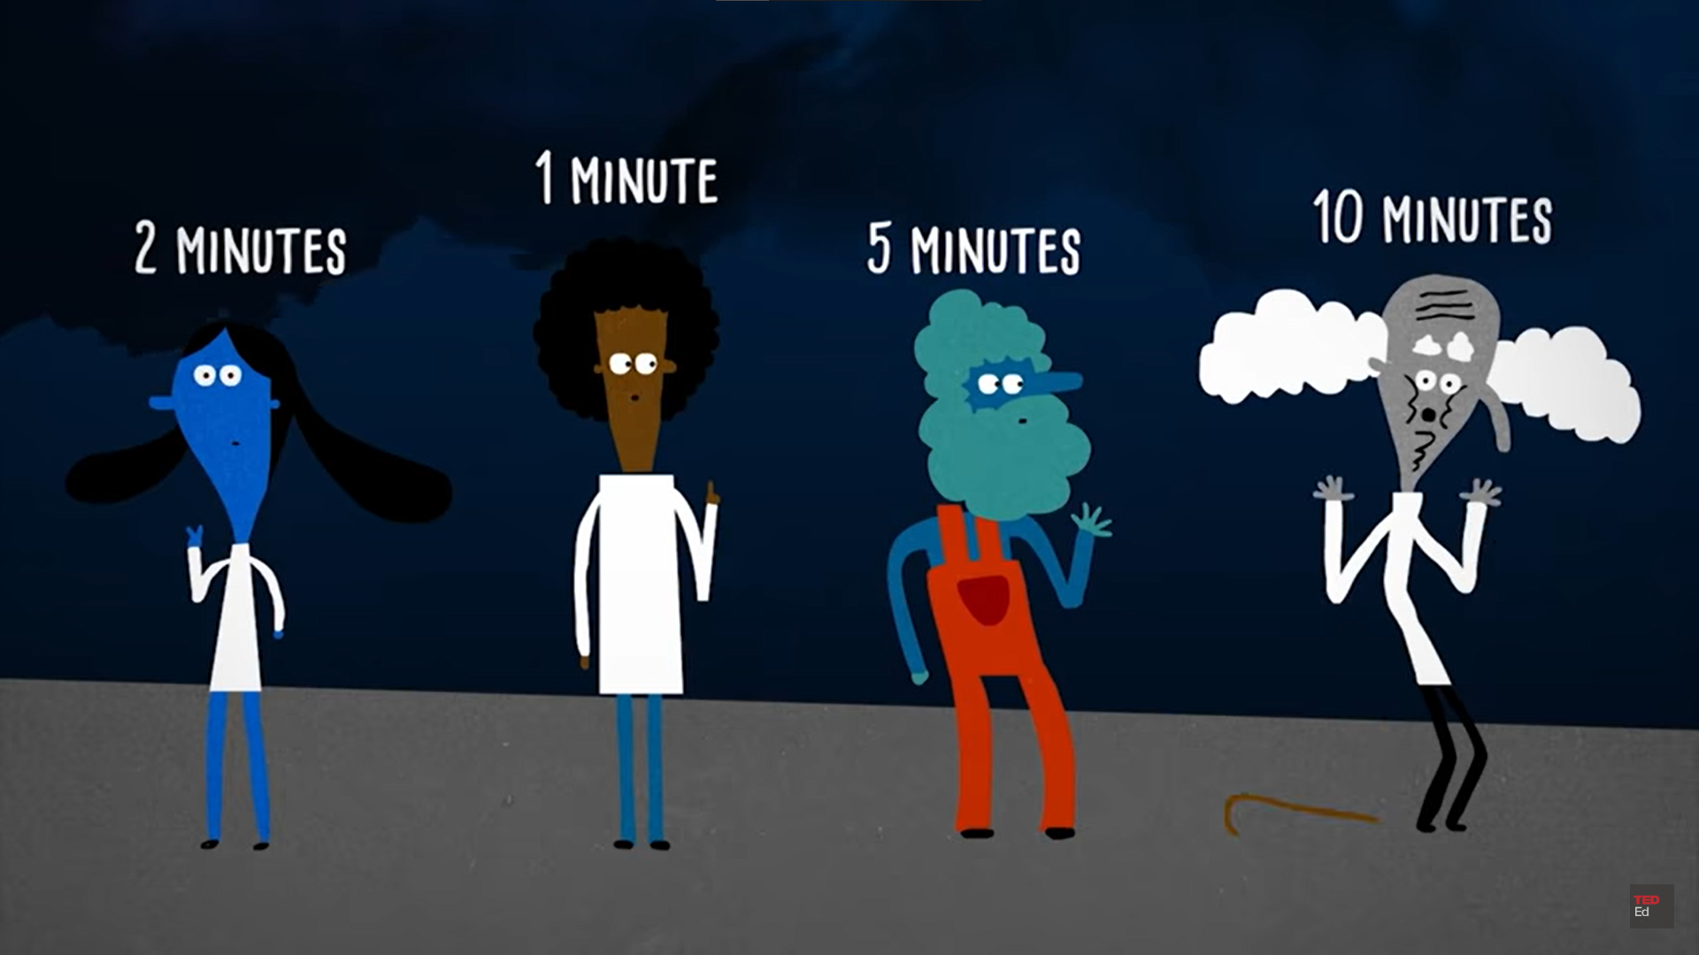

Slide 28
SOLUTION:
First Round: 1+2 = 2. Total Time Taken: 2 mins
1 will return = 1 Total Time Taken : 3 mins
Second Round: 10+5 = 10 Total Time Taken : 13 mins
2 will return = 2 Total Time Taken : 15 mins
Third Round: 1+2=2 Total Time Taken: 17 mins

Slide 29
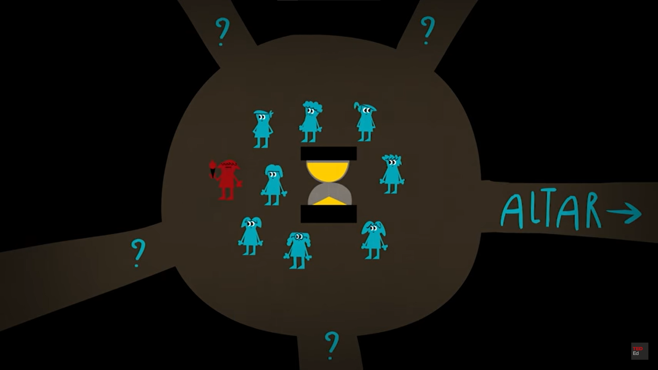

Slide 30
